Slide 1
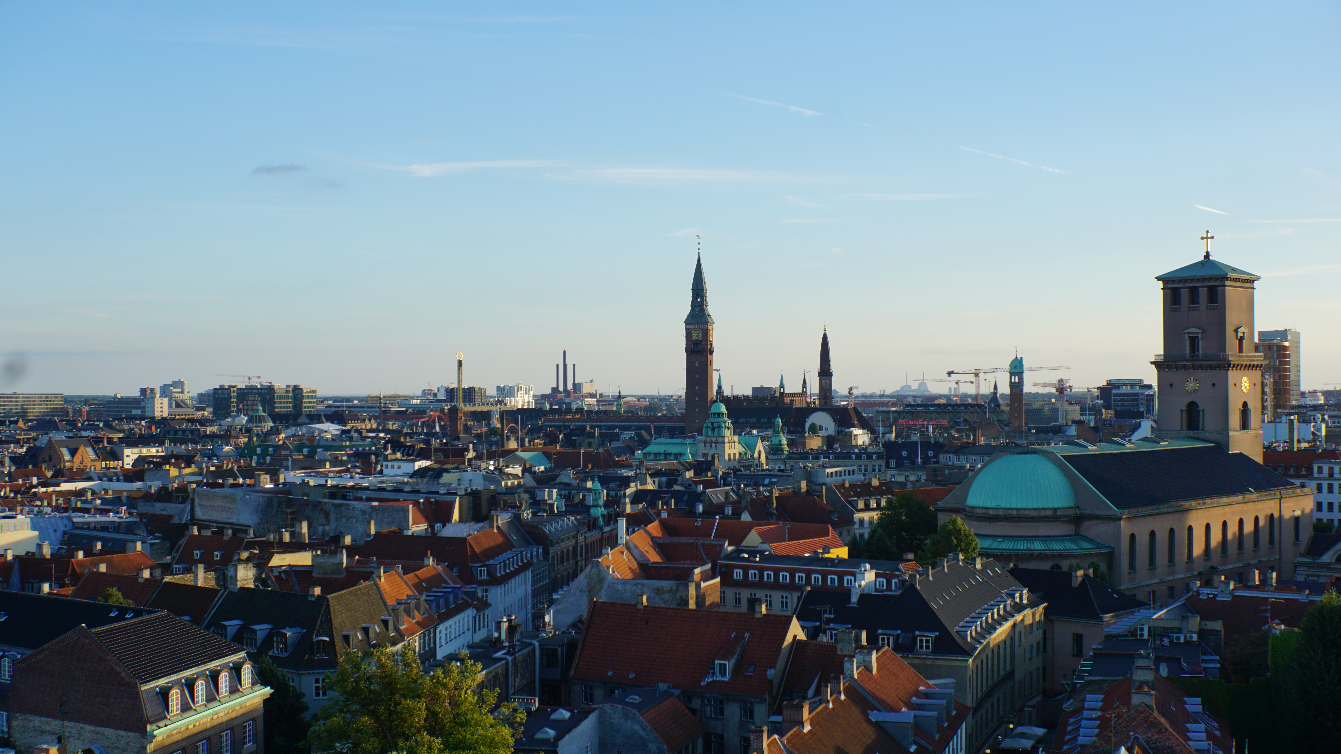
Copenhagen, Denmark

